Slide 1
Food industry (continued)
Kellogg’s Apple Jacks campaign in mid-2000s. They decided that apple had become problematic to them and that kids were not as drawn to them as in past decades. In their marketing/advertising the apple (=bad guy) vs. cinnamon stick (=good guy). Kellogg changed the add after nutrition advocates complained.
Kellogg’s campaign to sell frosted Mini-Wheats as brain food. Kids who ate FMM would be as much as 20% more alert in the classroom.

Slide 2
Statistics
The average American consumes as much as 33 lbs of cheese a year.
On average we consume 71 lbs of sugar per year.
That’s 22 teaspoons of sugar per day.
The amount is split equally 3 ways with sugar derived from:
Sugar cane
Sugar beets
Corn sweeteners, including high fructose corn syrup

Slide 3
Statistics continued
In 2011, we consumed 32 gallons of sugar-sweetened soda.
The consumption of other sweet drinks like tea, sport ades, vitamin waters, and energy drinks have doubled the past decade to 14 gallons a person.

Slide 4
How is HFCS made?
Corn Starch consisting of Amylose and Amylopectin
Heat
Chemicals
α- and β-Amylase
Dextrins and Maltodextrins
Heat
Chemicals
Glucoamylase
a.k.a. amyloglucosidase
Glucose syrup a.k.a.: Corn syrup
Glucose Isomerase: Column immobilized
HFCS-90
Blending with Glucose Syrup
HFCS-55
HFCS-42
vcnwosu.blogspot.com
Notes:
Corn starch is comprised of glucose molecules of infinite lengths, consists of amylose and amylopectin and requires heat, caustic soda and/or hydrochloric acid plus the activity of a number of different enzymes to break it down HFCS is a product made possible by the activity of various enzymes of microbial origin. HFCS is produced from corn. The

Slide 5
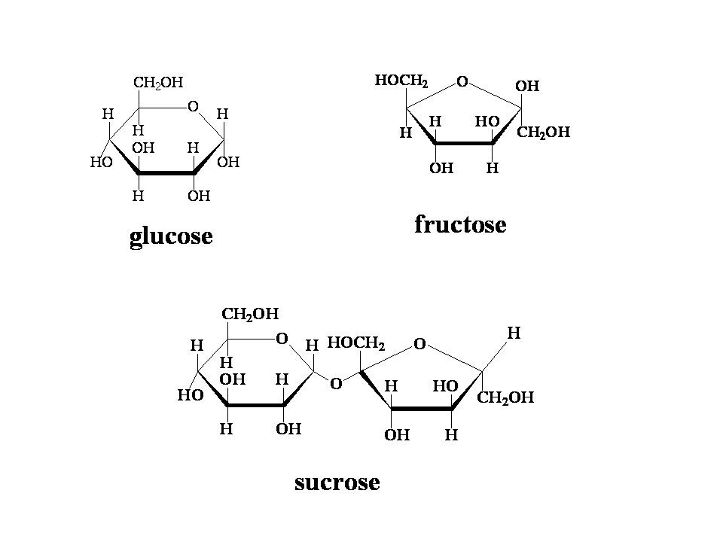
HFCS Molecule vs. Sucrose Molecule
bondingwithfood.wordpress.com

Slide 6
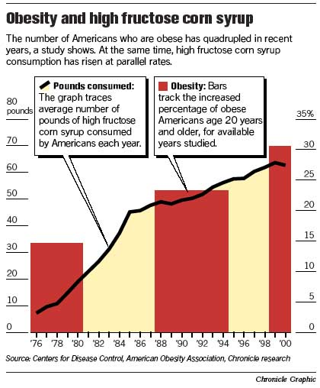
Fructose is 40% sweeter than sucrose and twice as sweet as glucose→ saves $$$
Fructose comes from fruit, although most fruit contains an mix of glucose, sucrose, and fructose
HFCS consumption had risen from < 10 lbs per person per year in 1976 to >50 lbs by 2000
Obesity and diabetes followed the HFCS trend until the 2000s when HFCS intake started to decline

Slide 7
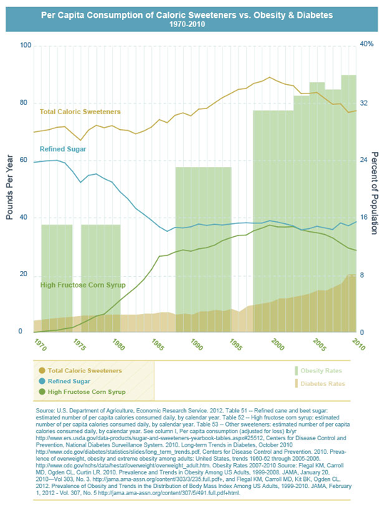

Slide 8
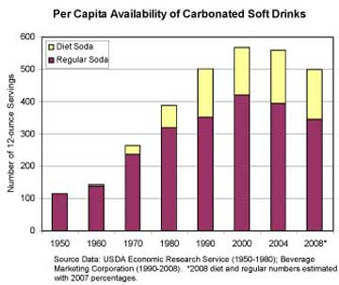
HFCS consumption is declining as regular soft drink availability is declining yet obesity and diabetes are still rising…it’s not ALL about what we eat and drink---think exercise component?
Notes:
Despite the first-ever per-capita declines in soft drink sales, companies still sold more than 14 billion gallons of calorie laden soft drinks in 2008. That’s equivalent to about 506 12-oz servings per year, or 1.4 12-oz servings per day for every man, woman and child. Those drinks include regular carbonated sodas, energy drinks, sports drinks, fruit drinks, ready-to-drink teas, and vitamin waters.

Slide 9
Fructose Levels in Common Foods
3” small navel orange = 3.1 gm
12 oz orange juice = 14.4 gm*
12 oz orange soda = 24 gm*
32 oz Cefco Fountain Coca-Cola = 57 gm*
* 100% natural OJ is 50% fructose; HFCS in soft drinks is approximately 55% fructose.

Slide 10
How Does the Body “react” to Fructose?
Fructose in HFCS is “free” (not attached to glucose molecule like sucrose)
It is transported in the digestive tract DIFFERENT from glucose
Enters portal circulation quickly and is almost entirely metabolized by the liver (70% of fructose is metabolized in hepatocytes)
Does not require insulin for hepatic uptake

Slide 11
So, the bottom line is that fructose consumption results in unregulated lipogenesis
The more fructose consumed, the more triglycerides the liver produces!
Lots of Fructose = Lots of Triglycerides
Bottom line: consumption of large amounts of fructose such as that found in HFCS-sweetened products has irrefutable health related consequences.

Slide 12
Salt
Salt manufacturers have as many as 40 types of salt that are manipulated, reformed, shaped to maximize the allure or “flavor burst”.
E.g. kosher salt that looks like snow, but shaped like a pyramid, but hollowed out on the inside so that saliva has a greater contact with the salt and thus the rush to the brain can hit your taste buds 3x as fast as ordinary salt does.
Is salt addictive? Current studies supporting this is confined to animal models.

Slide 13
Salt
In humans salt intake has traditionally been conceived as a learned preference rather than an addiction.
The preference for salty foods is likely learned in early life.
People’s taste for salt can be retrained.
The 2005 Dietary Guidelines for Americans provided a “tolerable upper intake level” of 2,300 mg per day.

Slide 14
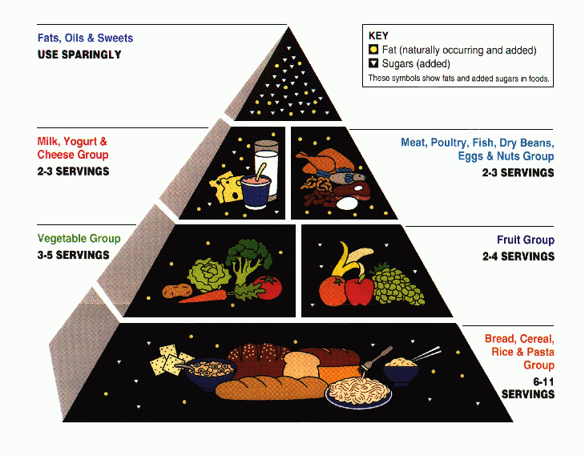
USDA Food Pyramid circa 2005
Notes:
The “Food Pyramid”, the federal nutrition guide released in 1974 and revised every 5 years, culminating with “MyPyramid” in 2005, was never based on science.

Slide 15
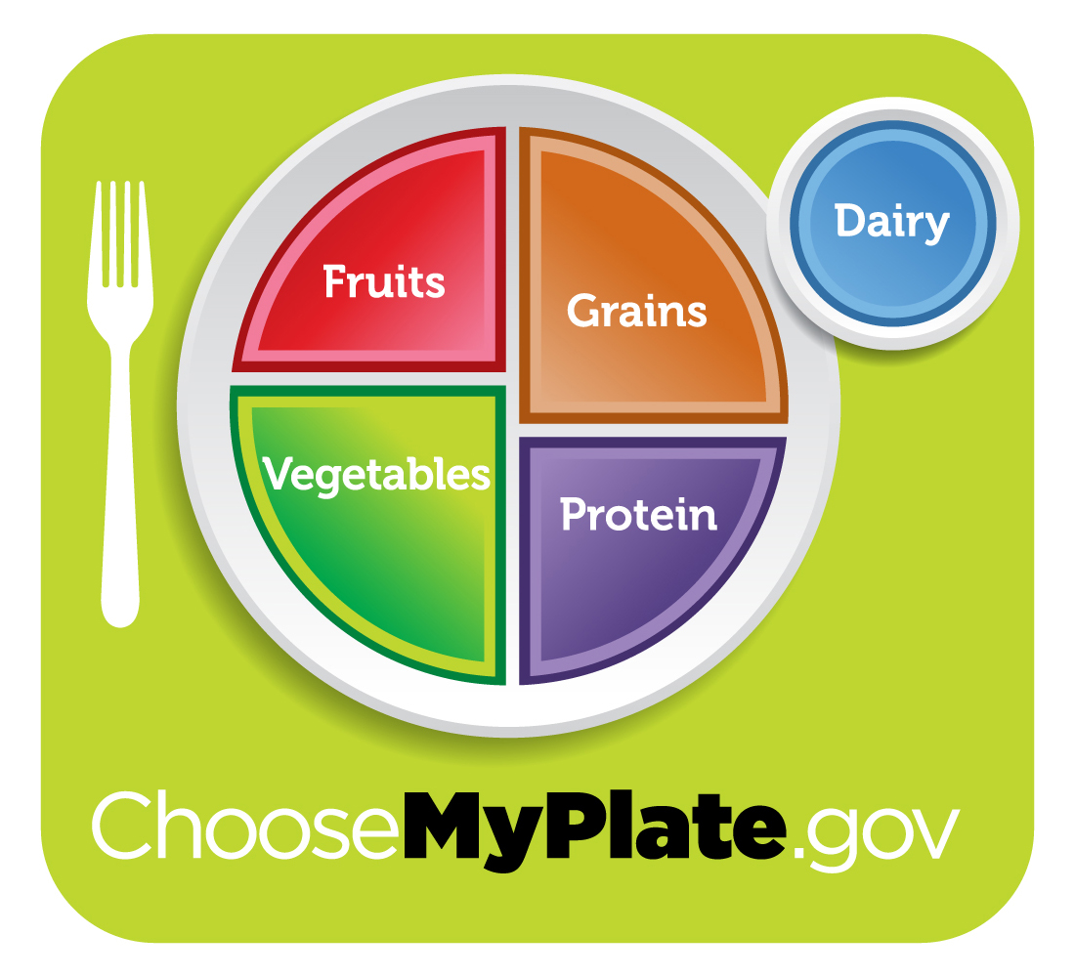
USDA adopted MyPlate in 2011
Notes:
In response to calls from many in the medical community, the pyramid was changed and morphed into “MyPlate”. This was in response to the Dietary Guidelines Advisory Committee, released in 2010, that obesity is a problem so we should all eat less fat, sugar and salt. We’re all supposed to eat more fruits and vegetables and less of everything else.

Slide 16
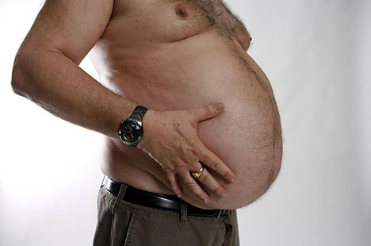
METABOLIC SYNDROME
BIG waist
BIG blood pressure
BIG cholesterol and triglycerides
BIG blood glucose (blood sugar)
Metabolic syndrome leads to higher risk
of diabetes and heart disease

Slide 17
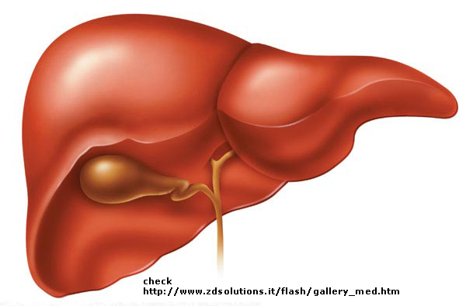
Your liver makes cholesterol and triglycerides in your blood
Genetic (inherited from family)
Too much sugar (carbohydrate) in diet
Too much fat in diet
Not enough exercise

Slide 18
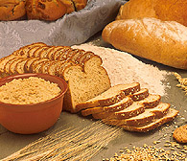
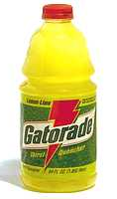
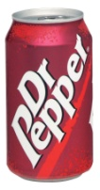
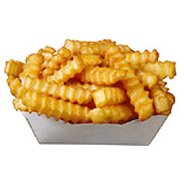

Carbohydrate (sugar and starches) Use small portions, or find an alternative. Use high fiber starches.
Raises blood sugar and triglycerides
Some are high in fat AND carbohydrate
Examples:
Desserts Rice
Regular sodas Potatoes
Sport drinks Bread
Honey, sugar Pasta
Candy

Slide 19
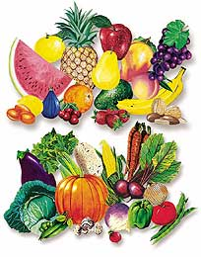
Fiber
Eat a wide variety of fiber foods to gain all the health benefits. We need
25-30 grams of fiber each day.
Ways to get more fiber:
Choose cold cereal with 5g fiber or more per serving
Choose oatmeal for cooked cereal
Choose beans or peas for a starch
Eat whole fruit instead of juice
Increase green vegetables (raw or cooked)
Switch to high fiber versions of foods you eat: bread, tortillas, granola bars, pasta, rice.

Slide 20
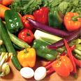
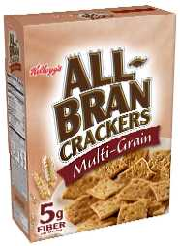

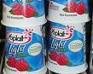
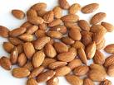
Vegetables and Healthy Snacking: Some Great Choices!
Add more non-starchy vegetables to meals and snacks.
Use whole fruits and vegetables (fresh and frozen are usually best).
Unsalted versions of low fat chips, whole grain crackers, or nuts.
High fiber cereal
Low fat cheese and yogurt

Slide 21
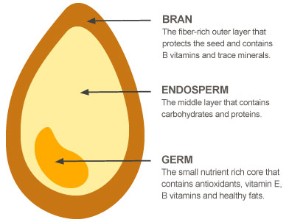
What is a Whole Grain?

Slide 22
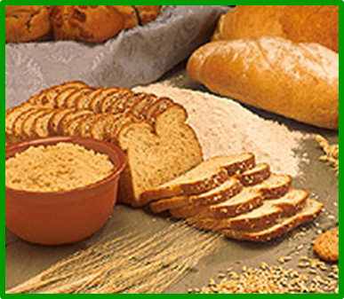

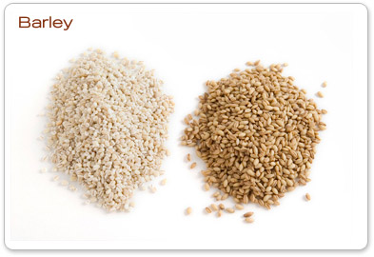
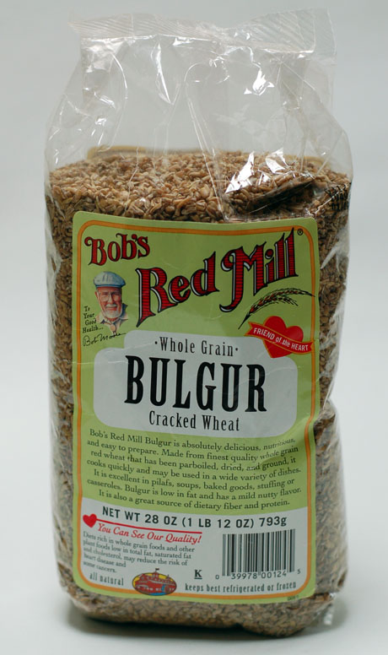
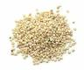
List of whole grains
Amaranth
Whole grain barley
Buckwheat (think Japanese soba noodles)
Corn/Whole cornmeal
Popcorn
Millet (leading staple grain in India)
Oats
Quinoa (from the Andes/Incas)
Rice (brown and colored)
Whole Rye
Sorghum (milo)
Teff (Ethiopia)
Triticale (hybrid wheat & rye)
Whole wheat
Spelt
Emmer, Farro, einkorn,
Kamut, Bulgur (tabbouleh),
Cracked wheat ,
Wheat berries
Wild Rice
Notes:
Amaranth (staple of the Aztec culture, peppery taste, higher level of protein 13-14% protein). Barley (tough hull, hulled barley is very slow-cooking, lightly pearled barley is technically not a whole grain since small amounts of bran are missing). Buckwheat (is a cousin of rhubarb, not technically a grain at all, and not a kind of wheat). Bulgur (when wheat kernels are boiled, dried cracked, and sorted by size). Kamut (ancient Eqyptian word for wheat). Farro/Emmer (

Slide 23
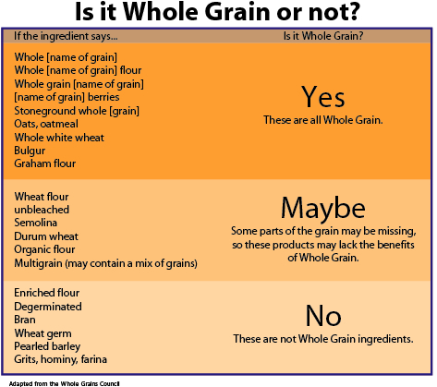

Slide 24

Watch wording on grains!
Foods are usually not whole grain products if labeled:
Multi-grain
Seven-grain
Stone-ground
100% wheat
Cracked wheat
Also the color is not an indication of whole grain.
Notes:
Multi-grain and seven-grain just means more than one grain. The grains used may or may note be whole grains. Stone-ground is a technique for grinding grain. It usually means that the grain is coarser and that the germ is intact. The bran portion may or may not be included. Some breads have caramel coloring added to make then look darker, like whole grains.

Slide 25
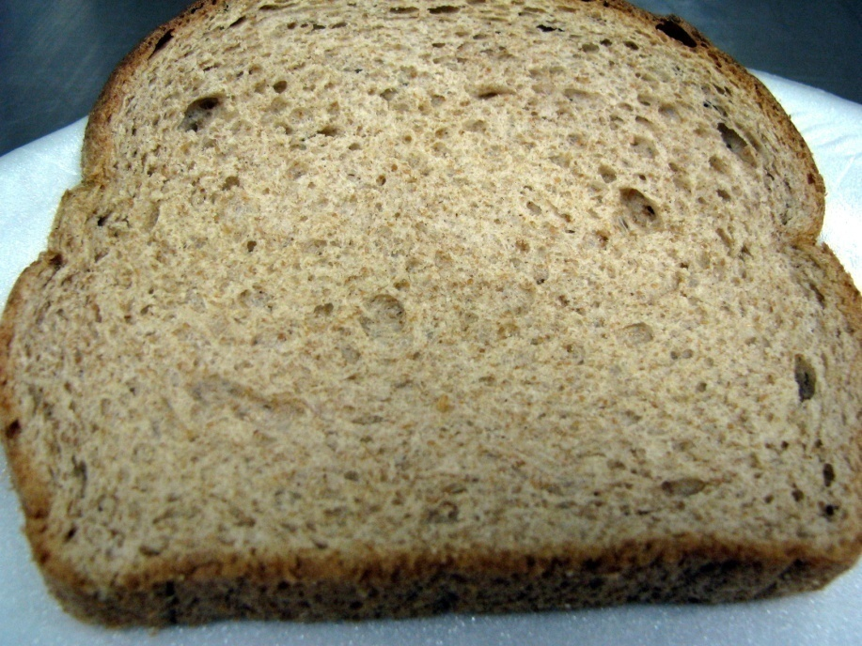
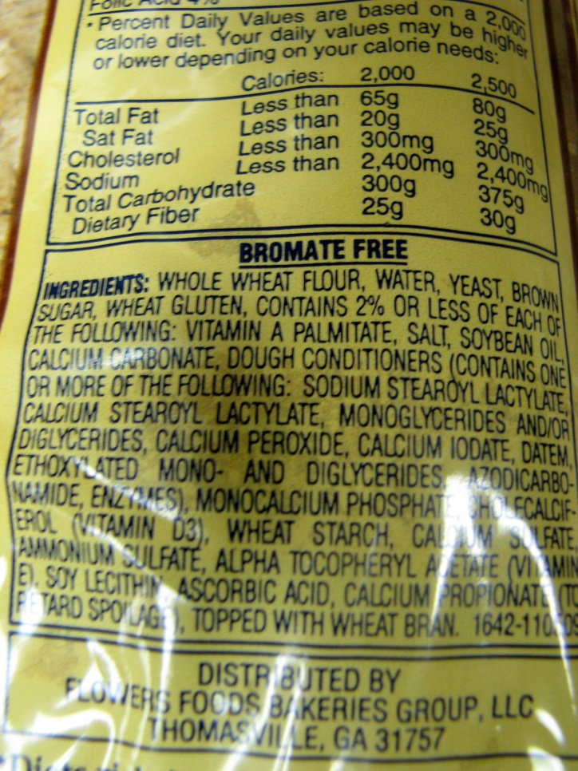
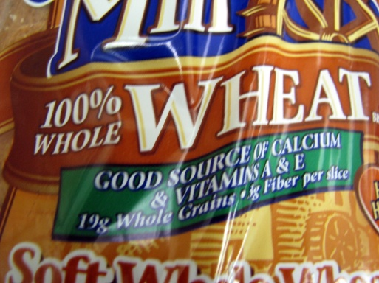
Product “A”- Whole Wheat

Slide 26
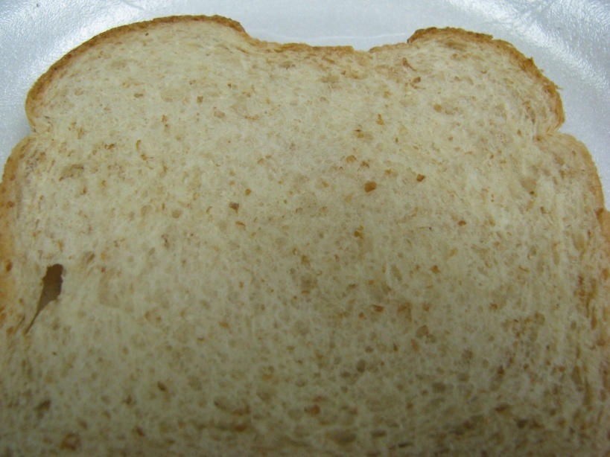
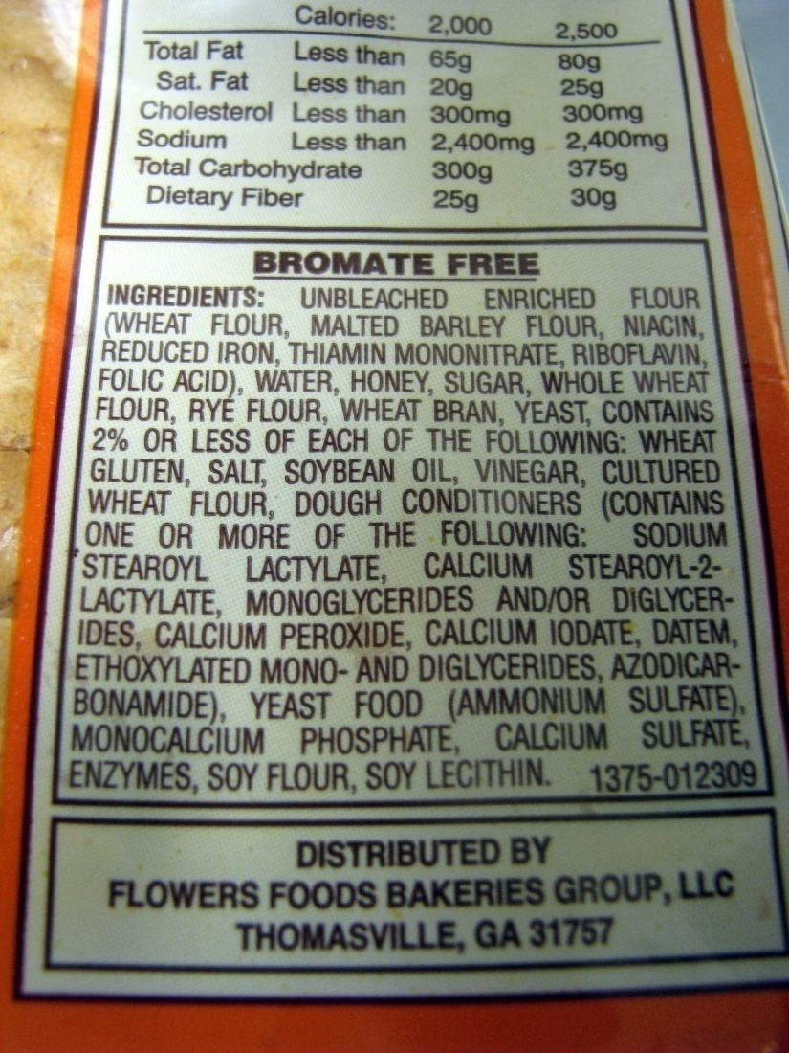
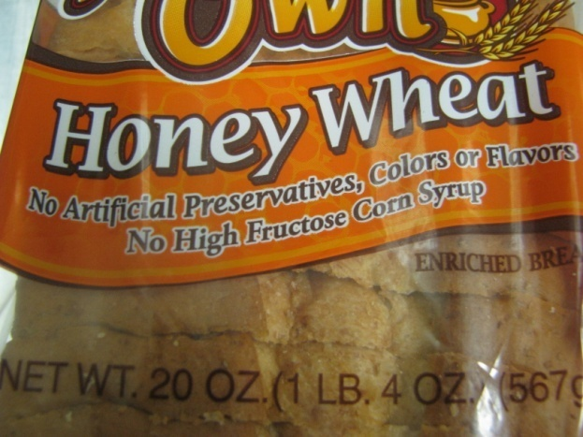
Product “B”- Partial Blend

Slide 27
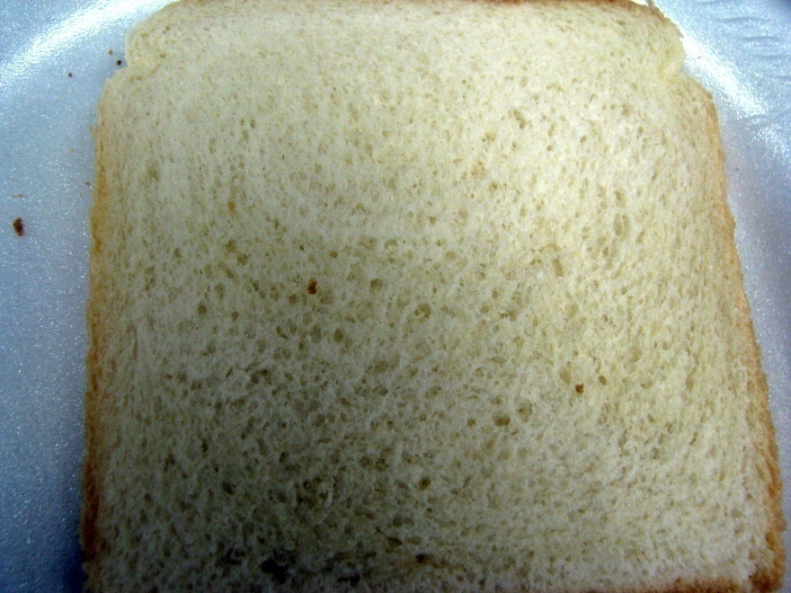
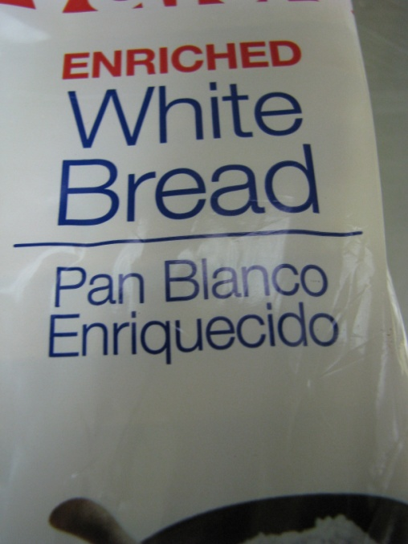
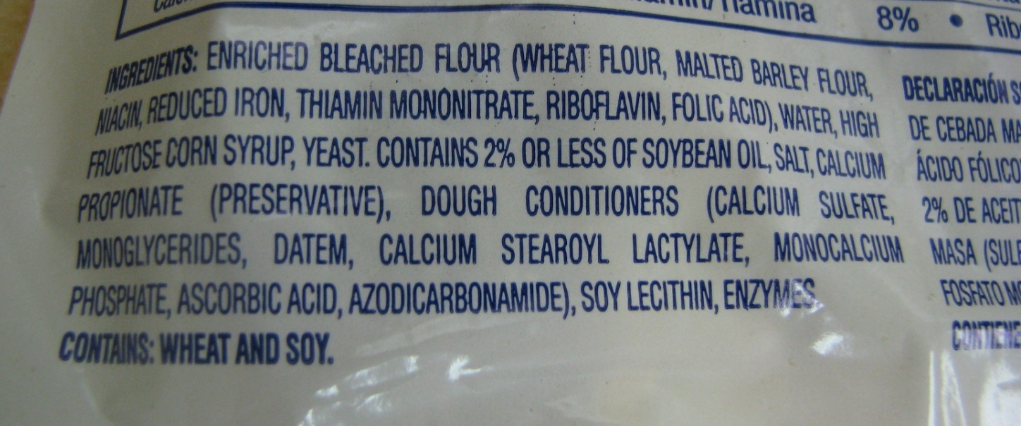
Product “C”- Refined

Slide 28
Fat
Fat doesn’t have a ‘bliss point’ like sugar does. There is almost no limit to how much fat you’ll want in a food
Fat is often invisible. It comes in oils and solids. Saturated fat is a solid fat
Cheese as an example of a fat additive to food that has contributed significantly to the obesity crisis.
Cheese has ‘mouthfeel’

Slide 29
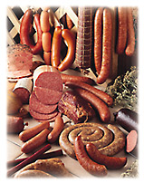
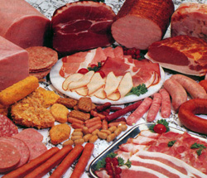
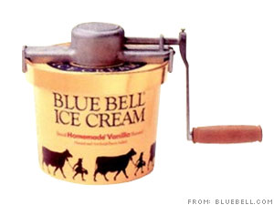

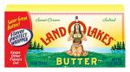

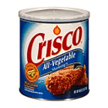
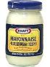
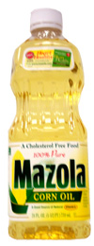



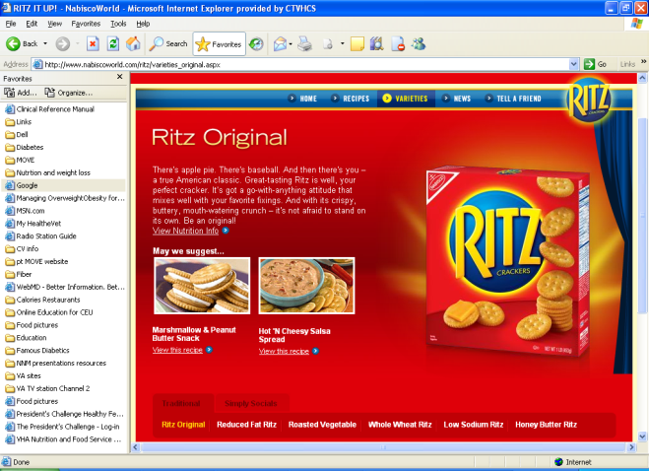
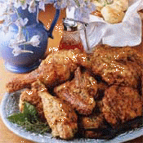
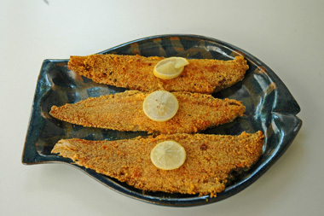
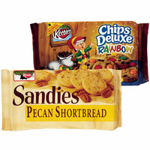

What foods are high in fat?
Animal Foods
Shortenings, oils, margarine, nuts
Fried foods, snack foods and candy

Slide 30
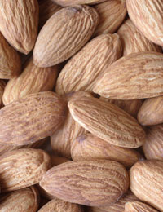
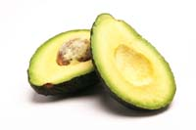
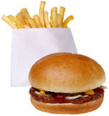
Types of Fat
“Good Fats”
Monounsaturated
Polyunsaturated
“Bad Fats”
Saturated
Hydrogenated
(trans fats)

Slide 31

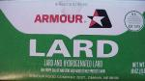
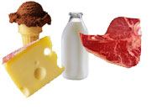
Saturated Fat
Animal Fat
Fatty meats, Whole Milk &
Milk Products, Butter
Lard
Coconut Oil
Palm Oil

Slide 32

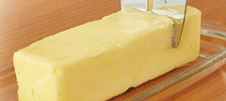
Trans Fat
(Hydrogenated Fat)
Shortening
Stick margarine
In most snacks and store bought desserts

Slide 33

Polyunsaturated Fat
Vegetable Oils
(Corn Oil, Soybean, Safflower, Sunflower)
Mayonnaise
Salad Dressings
Soft Margarines

Slide 34
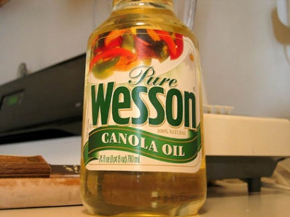
Monounsaturated Fat
Olive Oil, Canola Oil, Peanut Oil
Avocados, Olives
Nuts: walnuts, pecans, almonds

Slide 35
Meat, Poultry, Fish
Fish (contains omega-3 fatty acids which may reduce the risk of heart attack) - Cold water fish is best – Salmon, albacore tuna, sardines.
Poultry - white meat is the lowest in fat (chicken, turkey).
Wild game - venison, rabbit, squirrel.
Lean red meat - pork, beef, veal, lamb (round, sirloin, tenderloin).

Slide 36

Percent (%) Lean in meats (first number is the % lean; second number is the % fat of the product)
Ground beef:
70/30 = fatty meat
80/20 = better
90/10 = low fat
96/4 = very lean
Ground turkey = 97/3 available
Skinless chicken = 98/2
The seven leanest cuts for “red meat” are: eye round, top round, round tip, top sirloin, bottom round, top loin, and tenderloin.

Slide 37




Good Choices in Preparation
Choose leaner cuts of meat
Trim any visible fat
Remove skin from poultry
Skim fat from the top of soups, stews and others foods.
Grill, bake, broil, steam rather than breading and deep frying foods.
Limit gravies
More Marbled
More Fat
Less Marbled
More Lean

Slide 38
Processed Meats
Limit these due to HIGH fat and sodium content.
Choose 97% fat free versions for occasional use.
Bacon Bologna
Sausages Salami
Hot Dogs Most cold cuts
Hot links Most canned chili & stew

Slide 39

Eggs and Milk
Milk
Whole 4.5% fat
Reduced fat 2.0% fat
Low fat 1.0% fat
Nonfat (skim) 0 fat
Choose reduced-fat 1% or fat-free products.
Try moving down slowly. Your taste buds will adjust!
Flavored milk such as chocolate has higher carb (sugar) content.
Eggs are OK!
7 per week
Limit :
High-fat side dishes like bacon, sausage, and fried hash browns
High-carb dishes like pancakes, syrup, and donuts at breakfast

Slide 40

Salt (Sodium)
Do not use salt at the table.
When cooking - cut salt by half.
Use fresh, frozen or low-sodium canned vegetables.
Avoid processed meats & convenience foods.
Cut back on sodium, not on flavor - use herbs and spices to add flavor.
Sea salt is not low sodium.
Avoid salted snack foods - such as pretzels, crackers and potato chips. Use unsalted instead.

Slide 41
Salt (sodium) continued
Reduce daily sodium to less than 2,300 mg and further reduce to 1,500 mg in persons who are 51 and older and those of any age who have hypertension, diabetes, or chronic kidney disease.
1/4 teaspoon salt = 600 mg sodium
1/2 teaspoon salt = 1,200 mg sodium
3/4 teaspoon salt = 1,800 mg sodium
1 teaspoon salt = 2,400 mg sodium

Slide 42
C:\Documents and Settings\vhactxvanicj\Desktop\CV Workbook Nutrition Jan 2006.ppt

Slide 43



Cut the Fat and Calories
Hotdog #1
Hotdog #2

Slide 44
Eating Out
Use restraint at “all you can eat” buffets.
Limit restaurant eating to twice a week.
Split the meal with someone.
Take part of it home for another meal.
Ask for sauce, dressings, gravies on the side; use a small amount.
Choose wisely at salad bars.
Order less fried food.
Order water as your drink.

Slide 45


Beware of Portions!
Serving size:
3 ounce steak
8 ounce steak
12 ounce steak
16 ounce steak
Calories:
200-250
533-665
800-1,000
1,066-1,333
Remember, a calorie is a calorie no matter what the source. If you consume more calories than you need, you will gain weight.

Slide 46
Alcohol
May raise triglycerides.
Lots of calories, but no nutritional value.
Limit : 1-2 per day.
If you have diabetes: don’t drink alcohol on an empty stomach.
With some health conditions or medications, NO alcohol should be consumed -- ask your doctor.

Slide 47


How does your plate stack up?

Slide 48




It takes 2 to TANGO…
It’s easy to blame food, but we ALL know that it’s really about FOOD & PHYSICAL ACTIVITY
The couch + a Coke = you croak!
Ice cream + Atari = you’ll be sorry!
You get the picture.

Slide 49
QUESTIONS?

